Slide 1

CHICAGO CRIME ANALYSIS
Ashton r. wolf
Notes:
Good afternoon, everyone. I'm Ashton, representing the Data Warfare Team from Joint Base Lewis McChord, Washington.
Today, I'll be sharing my analysis of the Chicago Public Crime Database, spanning from 2001 to 2022.

Slide 2

Chicago crime analysis
As of 2023, the city of Chicago has one of the highest number of violent crimes per capita
This presentation will focus on recorded crimes from the years 2001 to 2022
The Chicago Crime Database is a product of collaborative efforts between the Chicago Police Department (CPD) and other relevant agencies
Notes:
As per the Chicago Sun Times, an analysis of crime statistics revealed that 2021 marked Chicago's most fatal year in nearly three decades. The elevated crime rate in Chicago compared to other major cities lacks a singular explanation. Reports on news platforms, online sources, and social media frequently highlight prevalent criminal incidents in Chicago, spanning violent crimes, gun violence, homicides, drug-related issues, and more.
Moreover, despite incarcerations, a 2018 report indicated that 43% of released prisoners in Illinois returned to criminal convictions and subsequent imprisonment.
To thoroughly understand this situation, I extensively explored a publicly available crime dataset provided by the City of Chicago. My main goal was to identify correlations related to criminal activity.

Slide 3


Exploratory Data Analysis
36 Crime Types
78 Community Areas
50 Wards
24 Districts
227 Locations
548 Crime Descriptions
63085 Blocks
What is in the dataset?
The dataset records more than 7,846,809 criminal incidents.
Categories of data
Notes:
The city of Chicago maintains a comprehensive dataset that documents various crime incidents occurring within the city.
At the time I acquired the dataset, it contained around 7.8 million incidents.
On the right side of this slide, you'll see the key features used for my data analysis, with the numbers representing the count of distinct values within each feature.
Extra: This data is sourced from the Chicago Police Department’s CLEAR (Citizen Law Enforcement Analysis and Reporting) system.

Slide 4
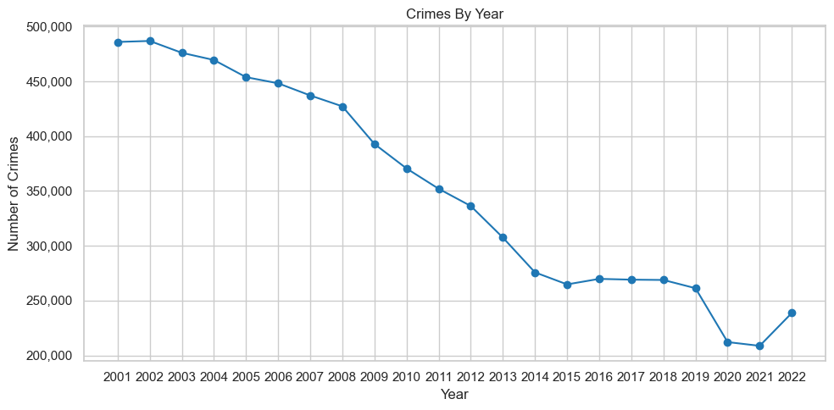
Total Crimes Committed
Notes:
Looking at the initial analysis, it turns out that, contrary to what many people think, the number of recorded crimes per year has decreased by more than half since 2001.
Here are three big observations I want to point out:
Between 2001 and 2015, the number of crimes per year went down gradually from about 475,000 to around 260,000 in 2015.
From 2015 to 2019, the crime rate stayed pretty much the same.
Then, between 2020 and 2021, there was another big drop.
One possible reason for this could be the Covid-19 lockdowns and changes in how police handled and reported crimes during that time. This doesn't necessarily mean there were fewer crimes happening, but it could mean they just weren't getting recorded in the same way.

Slide 5
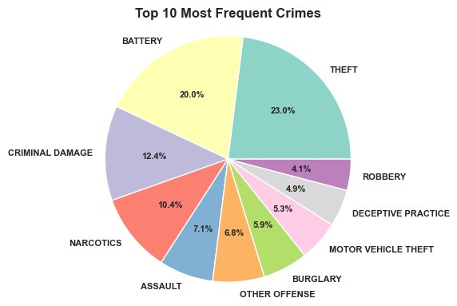
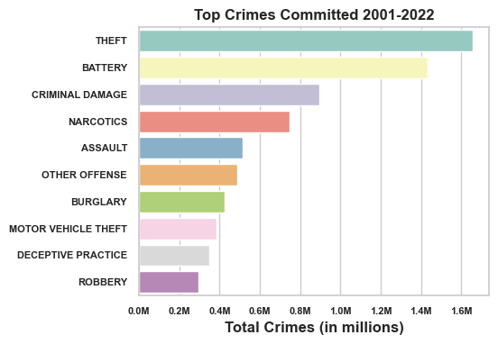
Top Crimes Committed
Notes:
The left-side pie chart portrays the most frequently occurring crimes, while the right-side horizontal bar chart illustrates the total occurrences over the specified time period.
Upon analyzing all 36 crime categories, it became evident that the top 10 crimes depicted in the pie chart constitute 91.57% of the total reported crimes.

Slide 6
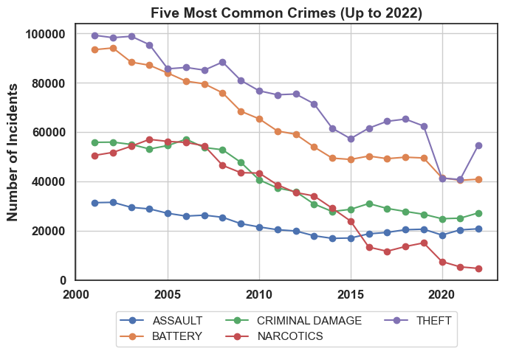
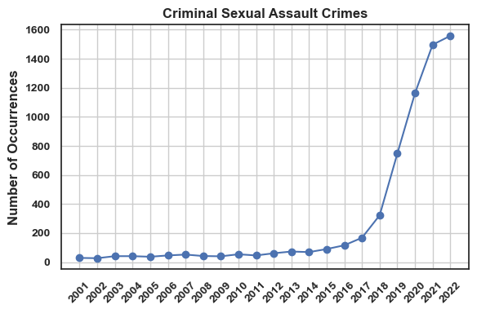
MOST COMMON CRIMES
Notes:
To explore with precision, I analyzed the top 5 most common crimes. Noteworthy is the decline in theft, battery, and narcotics.
Conversely, criminal sexual assault crimes showed a staggering 2,454% increase from 2012 to 2022. To avoid distortion, a separate chart was designed.

Slide 7
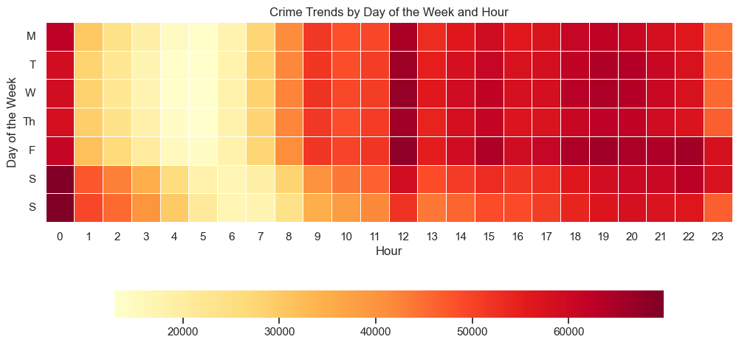
Notes:
I will now present the identified crime trends:
This heatmap illustrates the correlation between the day of the week and the time of day when crimes are most prone to occur. Key insights emerge from this data:
Crimes are less probable during weekdays between 01:00 and 07:00, with a slightly elevated likelihood during the same hours on weekends.
Friday evenings from 18:00 to 22:00 exhibit a very high likelihood of crime occurrence, closely followed by Tuesdays and Wednesdays.
Midnight hours during weekends record the peak probability of incidents.

Slide 8



HYPOTHESIS TEST
nULL
alternate
The probability of getting arrested has no relationship with crime type and location.
Arrest probability depends on the type of crime and location it is committed
Notes:
During my analysis I constructed a hypothesis test.
My Null Hypothesis assumes no link between independent variables and arrest occurrences. The Alternative Hypothesis suggests a significant relationship.
Exploring further, I used logistic regression in Exploratory Data Analysis to validate or reject the Null Hypothesis.

Slide 9
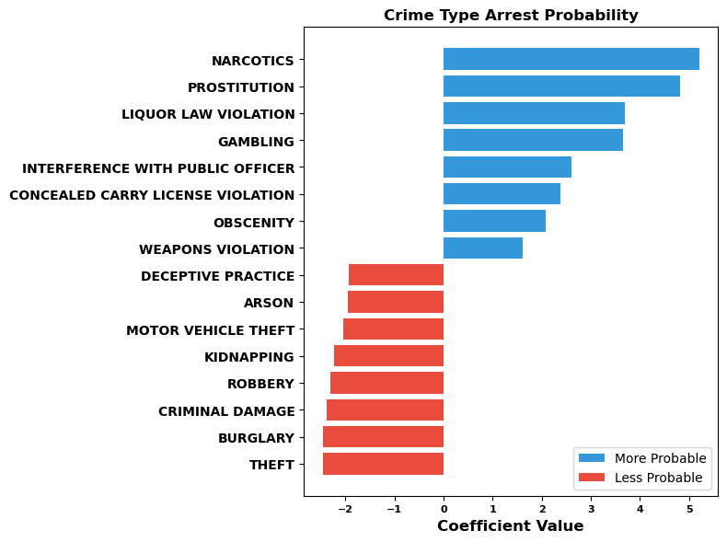
Logistic regression results crimes
POSITIVE coefficients indicate that a higher probability of that crime will result in arrest.
NEGATIVE coefficients indicate that a lower probability of arrest.
Notes:
Utilizing my findings, I isolated the most significant positive and negative deviations from the Null Hypothesis—highlighting the top 8.
These deviations are visualized on the adjacent bar graph.
Extended blue bars indicate crimes with a HIGHER likelihood of arrest, while red bars denote the opposite—LOWER likelihood of arrest.
The chart underscores that narcotics and prostitution-related crimes exhibit the highest probability of arrest, whereas theft and burglary demonstrate the lowest likelihood.

Slide 10
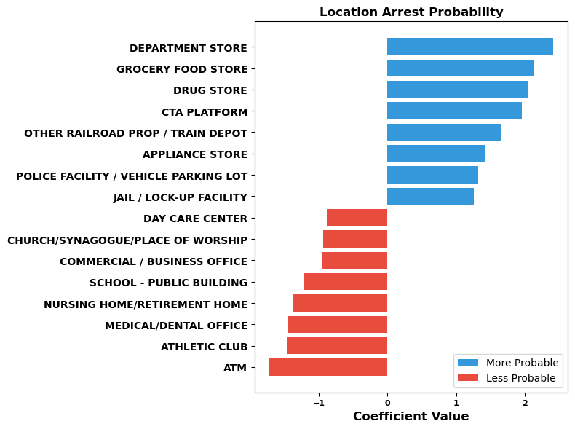
Logistic regression results location
POSITIVE coefficients indicate that a higher probability of that crime will result in arrest.
NEGATIVE coefficients indicate that a lower probability of arrest.
Notes:
On this accompanying slide, our attention shifts to the crime locations. The graph notably depicts that criminal activities within commercial establishments, including department, grocery, and drug stores, exhibit the highest arrest probability. In contrast, ATMs and athletic clubs show significantly lower arrest probabilities.

Slide 11
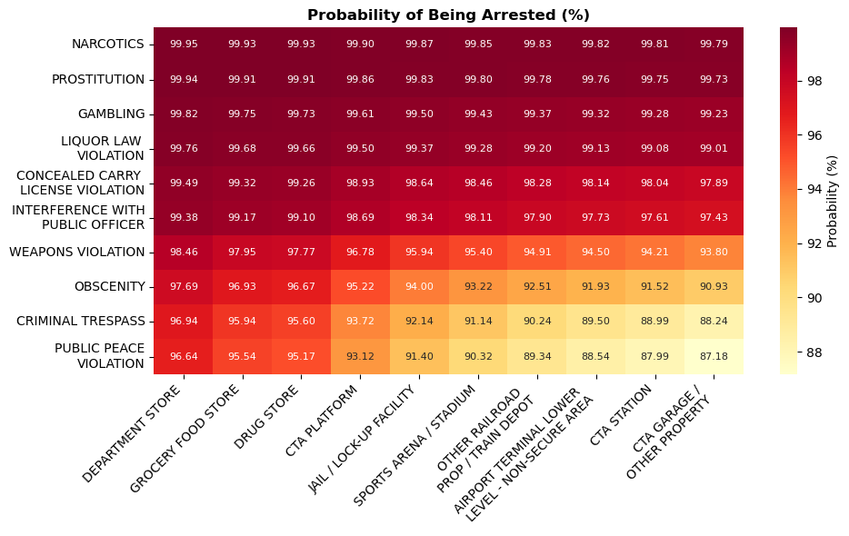
Probability heatmap by crime and location
Notes:
To provide a more detailed perspective, I cross-referenced the arrest probabilities of the prominent crimes with specific locations, resulting in an intersectional heatmap. This visual display showcases the likelihood of arrest for various crime-location pairings. Each cell represents the percentage probability of arrest when a particular crime is linked to a specific location.
The bar charts presented earlier clearly establish a correlation between arrest rates and other pertinent factors. In this instance, we narrowed our focus to crime type and location.
As witnessed in the preceding slides, narcotics emerged as the predominant crime, and department stores as the primary location. These two facets converge in the heatmap, highlighting department stores as the central hub for the prevalent crimes identified in our analysis.
To conclude, this graph definitively reveals the interrelation between crime types, their locations, and the arrest probability.
Our analysis leads to the rejection of the null hypothesis (H0) due to the evident non-random correlation between crime types, locations, and arrest probabilities. In simple terms, certain combinations of criminal activities and their respective locations exhibit distinct probabilities of arrests.

Slide 12




Thank you!
Ashton.r.wolf.mil@army.mil
wolfman1986(ashtonw) (github.com)
www.linkedin.com/in/Ashton-wolf
Crimes - 2001 to Present | City of Chicago | Data Portal
Notes:
Thank you for being a part of my presentation. You can find my contact information on this slide.

Slide 13

Database
The Chicago Crime Database is a comprehensive repository of crime-related data collected and maintained by law enforcement agencies in the city of Chicago, Illinois, USA. The database serves as a critical tool for researchers, policymakers, and law enforcement professionals to analyze crime trends, identify patterns, and develop effective strategies to enhance public safety and well-being.
Data Collection: The Chicago Crime Database is a product of collaborative efforts between the Chicago Police Department (CPD) and other relevant agencies. It aggregates a vast amount of crime-related information, including incident reports, arrest records, case details, and offender profiles. The data collection process is ongoing, ensuring that the database remains up-to-date and relevant for crime analysis.

